Slide 1
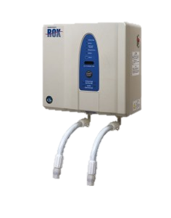
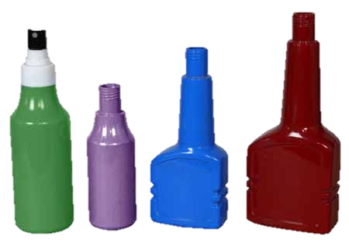
The Use of Electrolysed Water Vs Conventional Cleaning and Sanitising Products
Maazuza Othman, Sujeeva Setunge, Yuanmei Sha, Felicity Roddick
RMIT University
Introduction
Electrolysed water systems are a relatively new technology. Using salt and tap water, these systems generate two streams simultaneously. One is alkaline and the other is acidic, having the characteristics of cleaning and sanitising solutions, respectively..
The electrolysed cleaning solution (alkaline) cleans surfaces through its diluted Sodium Hydroxide(NaOH) contents; whereas the sanitising solution contains diluted Sodium Hypochlorite (NaOCl) delivering mild activate ORP. Typical characteristics of electrolysed sanitising and cleaning solutions are given in table 1.
Table 1: Characteristics of electrolysed water solutions produced by ROX systems
Methodology
Benchmarking analysis comparing electrolysed cleaning and sanitising solutions with conventional cleaning/sanitising products was undertaken in order to assess the benefits of the options. The criteria for analysis included environmental, social, economic and technical factors (Figure 2). Four categories of conventional packaged cleaning and sanitising solutions were selected for the benchmarking analysis. These are hand wash, disinfectant, floor wash, and degreaser. For each category, three or more products found in use by the different sectors such as the food-related business and commercial buildings, as per the surveys, were included in the analysis. To assess the cost effectiveness of these systems, the study data from customers currently using eWater Systems and those using conventional cleaning and sanitising products was collected.
Salt +Water
Electrodes
+ -
Benchmarking
Environmental Factors
Energy usage
Waste
Social Factors
Risks of exposure
Economic Factors
Technical Factors
Biodegradability
Ecotoxicology
Noise level
Odour or fragrance
Space required
Capital costs
Operational costs
Materials
waste deposit
maintenance
Maintenance requirement
Ease of use
H2O
HOCl
H2O
NaOH
Membrane
Sanitising solution
Cleaning
solution
Figure 1: Electrolysed Water Generation Concept Model
 | Sanitising Solution | Cleaning Solution
pH range | <2.7 | ≥ 11.3
Chlorine Range | 40-50 ppm | -
ORP | 1000-1100 mV | <-795 mV
Dissolved Oxygen or Hydrogen | 15-20 ppm DO | 1.4 DH/ mg dm³ (H₂)
Activate Substances | HOCl , H2O | NaOH, H2O
Available Chlorine | 20-60 mg/kg | -
Figure2: Benchmarking analysis criteria
Results and a discussion
The benchmarking exercise showed the limitations in quantitative data, especially concerning conventional products. Consequently, where needed assumptions were made and the comparison was performed for different potential customers and usage requirements.
The advantages and disadvantages of the electrolysed water systems compared with conventional packaged clearing and sanitising products are given below:
Based on consumable costs, each litre of electrolysed water only costs $0.0022 to $0.0034, whereas the average cost of packaged disinfecting products is $0.10 per litre of diluted product. For the cases studied, the cost savings in using electrolysed water systems with pay back periods of 1.4 to 3.1 years.
Table 2: Payback period of case studies
Research objectives
Electrolysed solutions have been marketed as a replacement for conventional cleaning and sanitising products. In order to provide information for potential users, this study provides a comparison of electrolysed water systems with conventional cleaning and sanitising products available in the market.
This study aims to:
Identify the environmental, social and economic benefits of electrolysed water cleaning and sanitising solutions
Benchmarking of electrolysed water solutions against conventional packaged cleaning and sanitising products
The advantage of Electrolysed water system: | The disadvantage of Electrolysed water system:
No hazardous chemicals need to be handled Low operating cost Reduces chemicals discharged into the sewage Easy to handle ,no heavy lifting Generated on site, no the carbon footprint Minimises the packaged material, less waste. No residue foaming Less storage space is required Less allergy and skin reactions | Initial capital cost Require plumbing installation Might have excess solution Low level noise when machine operating
Materials
For benchmarking analysis this study selected electrolysed water production systems supplied by eWater Systems Australia, specifically Models ROX 10 and ROX 60 manufactured by Hoshizaki Japan.
Model ROX 10 is a simple to install compact wall mounted machine that produces the 2 streams of water on demand at up to 1.5 litres of each per minute. The Model ROX 60 is a more complex reticulated system with components including the main water electrolyser production plant, tanks and proprietary dispensers. It produces up to 6 litres of both Cleaning and Sanitising solution per minute. For comparison a range of conventional packaged cleaning and sanitising products frequently used by cleaning contractors as well as products available in supermarkets were selected
 | Users 1 | Users 2 | Users 3
ROX running hours | 1050 | 140 | 475
ROX installed period(month) | 18 | 1.5 | 4
ROX capacity(L/min of each stream) | 2.5 | 6 | 2.5
Monthly usage(L) | 17500 | 67200 | 35625
Capital cost ($) | 50,000 | 90,000 | 110,000
each litre saves ($) | 0.08225 | 0.08257 | 0.08258
Pay Back (yr) | 2.8 | 1.4 | 3.1
Vs.
Conclusion
Given the available information to the authors, it was found that electrolysed water has the potential to reduce the environmental impact and improve the safety in the work environment in comparison with the typical cleaning/ sanitising products, as well as it can be more economic over the long term.

